Slide 1
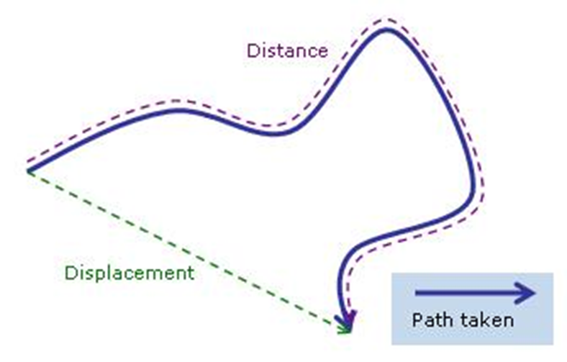
Vocabulary
Motion is the change in an object’s position relative to a reference point.
Reference Point is a nonmoving object that is used to compare motion
Distance is the amount of length between two points
Displacement is the distance and direction of an object’s change in position.
Describing Motion
Copyright © McGraw-Hill Education

Slide 2
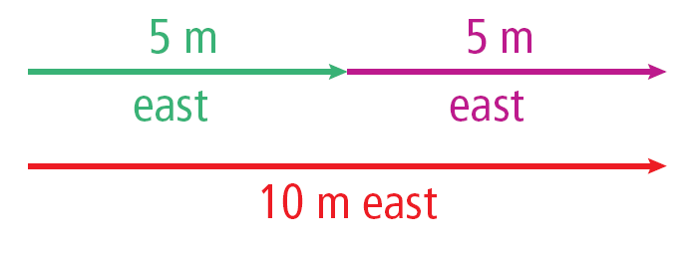
Adding Displacements
Displacements in the same direction can be added.
For example:
Describing Motion
Copyright © McGraw-Hill Education

Slide 3
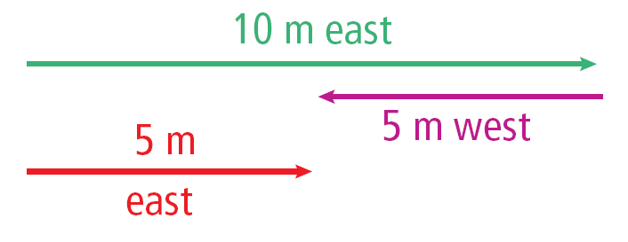
Adding Displacements
Displacements in opposite directions can be subtracted.
For example, if you walk 10m east and then 5m west, the size of your displacement is:
Describing Motion
Copyright © McGraw-Hill Education

Slide 4
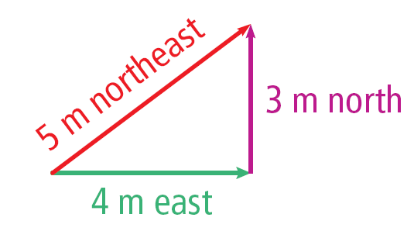
Adding Displacements
Displacements that are not in the same direction or in opposite directions cannot be directly added or subtracted.
For example, if you walk 4 m east and then 3 m north, your displacement is 5 m in a roughly northeast direction, but the total distance traveled is 7m.
Describing Motion
Copyright © McGraw-Hill Education

Slide 5
Speed is the distance an object travels per unit of time.
Calculating Speed
Any change over time is called a rate.
If you think of distance as the change in position, then speed is the rate at which distance is traveled or the rate of change is position.
Speed Equation
Describing Motion
Copyright © McGraw-Hill Education

Slide 6
CALCULATE SPEED
Use with Example Problem 1.
Problem
A car traveling at a constant speed covers a distance of 750 m in 25 s. What is the car’s speed?
SOLVE FOR THE UNKNOWN
Set Up the Problem
s = $\frac{\text{d}}{\text{t}}$ = $\frac{\text{750 }\text{m}}{\text{25 }\text{s}}$
Solve the Problem
s = $\frac{\text{750 }\text{m}}{\text{25 }\text{s}}$ = 30 m/s
Response
ANALYZE THE PROBLEM
KNOWN | UNKNOWN
distance: d = 750 m | speed: s
times: t = 25 s
EVALUATE THE ANSWER
30 m/s is approximately the speed limit on a U.S. interstate highway, so the answer is reasonable.
Describing Motion
Copyright © McGraw-Hill Education

Slide 7
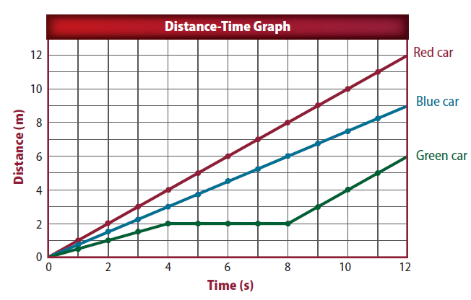
Distance-Time Graph
https://www.youtube.com/watch?v=l93-BkAJ3UY
Describing Motion
Copyright © McGraw-Hill Education

Slide 8
Average Speed
Average speed describes speed of motion when speed is changing.
Average speed is the total distance traveled divided by the total time of travel.
If the total distance traveled was 5 km and the total time was 1/4 h, or 0.25 h.
The average speed was:
Describing Motion
Copyright © McGraw-Hill Education

Slide 9
Graphing Motion
The motion of an object over a period of time can be shown on a distance-time graph.
Time is plotted along the horizontal axis of the graph and the distance traveled is plotted along the vertical axis of the graph.
Describing Motion
Copyright © McGraw-Hill Education

Slide 10
Graphing Motion
Once the scales for each axis are in place, the data points can be plotted.
After plotting the data points, draw a line connecting the points.
Describing Motion
Copyright © McGraw-Hill Education

Slide 11
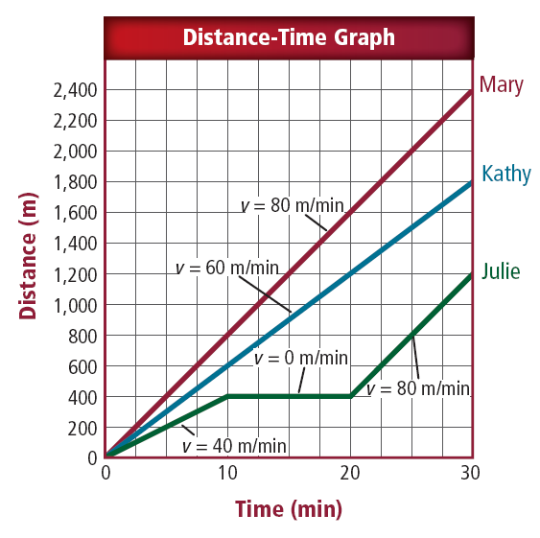
Speed on Distance-Time Graphs
The graph shows that the line representing the motion of the faster swimmer is steeper.
An object’s speed is equal to the slope of the line on a distance-time graph.
Describing Motion
Copyright © McGraw-Hill Education

Slide 12
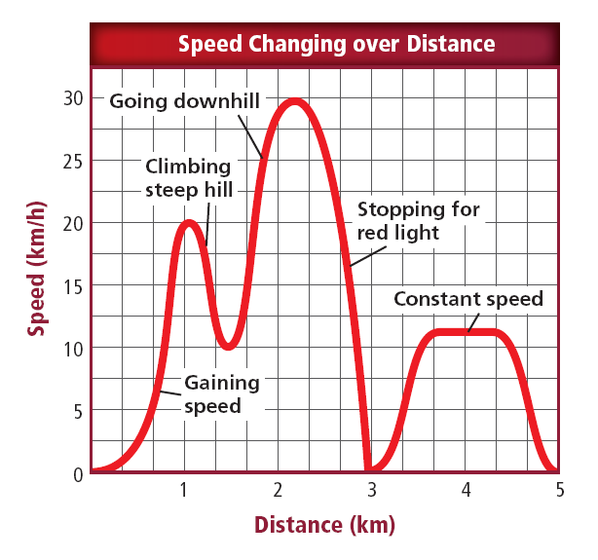
Changing Speed
Usually speed is not constant. How does the slope of the graph change when you speed up and slow down? What happens to the graph when you travel at constant speed or stop?
Instantaneous speed
The speed at a given point in time
Describing Motion
Copyright © McGraw-Hill Education

Slide 13
Review
Essential Questions
How are distance and displacement different?
How is an object’s speed calculated?
What information does a distance-time graph provided?
Vocabulary
motion
displacement
speed
Describing Motion
Copyright © McGraw-Hill Education

