Slide 1
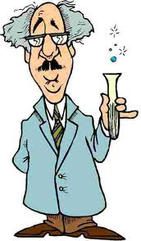
Scientific Inquiry

Slide 2
What is the scientific method?
Scientific method- A series of steps followed to solve problems.

Slide 3
Steps of the scientific method
Observation
Question
Hypothesis
Experiment
Results
Conclusion

Slide 4
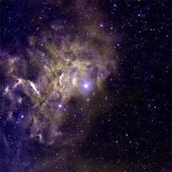
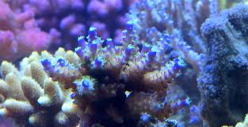
Most scientific questions begin with observations.
Observation– the results of using one or more of your senses to gather information and taking note of what occurs.

Slide 5
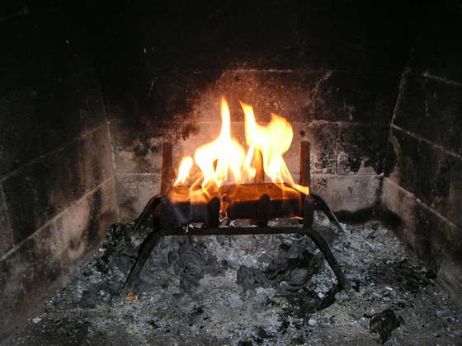
Question
Observations often lead to questions.
“When logs burn, what happens to the wood? Do the logs disappear? Do they change in some way?

Slide 6
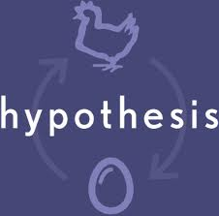
Making a Hypothesis (Prediction) Hypothesis– a possible explanation for an observation that can be tested by scientific investigations.

Slide 7
Making a strong hypothesis.
If ____________then___________
I think this because…….
1.
2.
Practice: We are going to do an experiment to test whether a white t-shirt or a black t-shirt will make you more uncomfortable on a hot sunny day. Make your prediction for the experiment.

Slide 8
Experiment
This is the where you follow the procedure and complete the experiment to test your hypothesis.
While an experiment is taking place data is collected and recorded.
The constant (thing that stays the same)during an experiment is called the control.

Slide 9
Variables
Independent variable - controlled by the experimenter.
The independent variable impacts the dependent variable
Dependent variable-changes in response to the independent variable

Slide 10
Experimental Group-the group that receives the treatment Control Group-the group that remains unchanged (normal)

Slide 11
Results
This is the portion after the experiment is complete. It will include
Any calculations you have made
Charts you have developed

Slide 12
Conclusion
After analyzing your results, you can begin to draw conclusions about your investigation.
A conclusion is a summary of the information gained from testing a hypothesis.
This is when you state whether your hypothesis was correct or incorrect and support this with data from your experiement.

Slide 13
Example Problem
You drive a pickup and make an observation about how much fuel you use up when you drive with your tailgate down. What type of observation might you make?
Write a hypothesis about your observations.
What is an experiment you could set up to test it? What components do you need in your experiment?

Slide 14
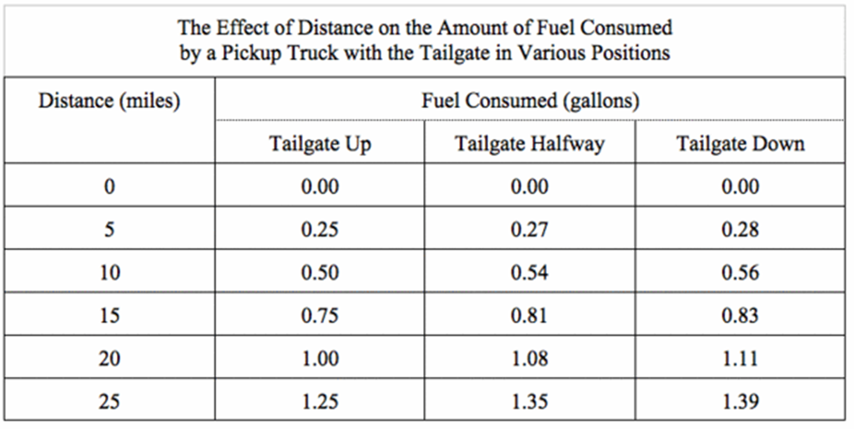
If this is your data, what might your conclusion be?
Would you accept or reject your hypothesis?

