Slide 1
Polyatomic ion-
AN ION THAT CONSISTS OF MORE THAN ONE ATOM

Slide 2
Polyatomic ions are made up of more than one atom
They still have an overall charge, formed from the combination of atoms
They can be positively or negatively charge

Slide 3
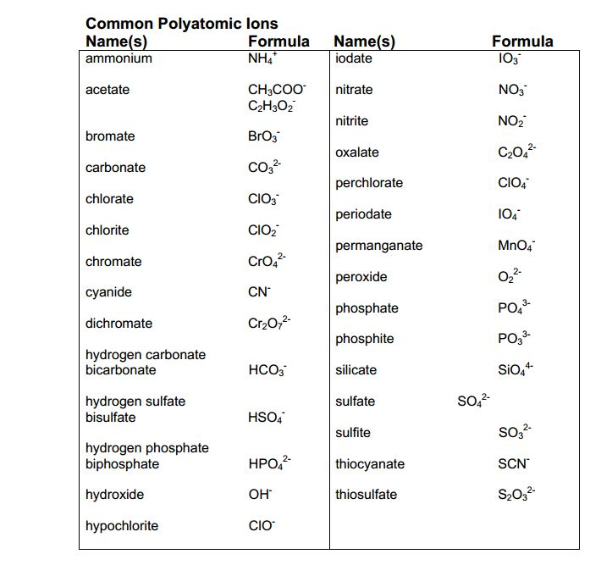

Slide 4
Chemical Formulas
The chemical formula of each polyatomic ion tells you how many atoms of each element there are
This is a polyatomic ion, since it is made up of more than one atom and these two types of atoms together have a charge (+)
This tells you there is one atom of Nitrogen (N) and 4 atoms of hydrogen (H)

Slide 5
Chemical Formulas cont.
The chemical formula of a polyatomic ion also tells you how the atoms are connected
This tells you the 4 hydrogen atoms are all connected to the nitrogen atom, since the H is right after the N. The polyatomic ion is placed in brackets [ ] and given a charge

Slide 6
Evaluate and draw the following
Thiosulfate
How many of each atom
What would it look like if you were to draw it?
Bromate
How many of each atom?
What would it look like if you were to draw it?

Slide 7
Evaluate and draw the following
Thiosulfate
How many of each atom
What would it look like if you were to draw it?
Bromate
How many of each atom?
What would it look like if you were to draw it?

Slide 8
Interpreting Picture
Now if you are given an image of the atom arrangement you should be able to identify which polyatomic ion it is.

Slide 9
Name the following polyatomic ions

Slide 10
Name the following polyatomic ions

Slide 11
If you are given the name of a polyatomic ion you can write the chemical formula using the criss-cross method
Beryllium hydroxide
1. Write the element and polyatomic ion with their charge
2. cross the charge down to OPPOSITE sides
3.Write the new formula with the subscripts (YOU NEED PARATHESIS IF THE NUMBER CROSSED DOWN TO THE POLYATOMIC ION IS MORE THAN ONE)

Slide 12
Practice: Write the chemical formulas for the following (it may be helpful to look at the steps on the last slide)
Lithium sulfite
Calcium Nitrite

Slide 13
Practice: Write the chemical formulas for the following (it may be helpful to look at the steps on the last slide)
Lithium sulfite
Calcium Nitrite

Slide 14
If the charges are equal in value they cancel each other and you don’t have to write either subscript
Calcium Carbonate

