Slide 1
Essential Questions
How are force and motion related?
How is the net force on an object determined?
Why is there friction between objects?
What is the difference between mass and weight?
Forces
Copyright © McGraw-Hill Education

Slide 2
Vocabulary
Review
mass
New
force
net force
friction
gravity
field
weight
Forces
Copyright © McGraw-Hill Education

Slide 3
What is force?
A force is a push or pull.
Sometimes it is obvious that a force has been applied (changing motion).
Sometimes it is not as noticeable, such as the force that the floor exerts on your feet.
Forces
Copyright © McGraw-Hill Education

Slide 4
Changing Motion
A force can cause the motion of an object to change.
If you have played billiards, you know that you can force a ball at rest to roll into a pocket by striking it with another ball.
The force of the moving ball causes the ball at rest to move in the direction of the force.
Forces
Copyright © McGraw-Hill Education

Slide 5
Net Force
Suppose two students standing side-by-side push on a box with the same force in the same direction.
These forces are unbalanced.
The net force that acts on this box is found by adding the two forces together.
The box will move.
Forces
Copyright © McGraw-Hill Education

Slide 6
Net Force
Suppose two students are standing on opposite sides of a box and push on it with the same force.
Forces on an object that are equal in size and opposite in direction are called balanced forces.
The net force on the box is zero because the two forces cancel each other.
The box will not move.
Describe the net force when two students stand on opposite sides of the box and push on it with unequal forces. Are the forces balanced or unbalanced?
Forces
Copyright © McGraw-Hill Education

Slide 7
Friction
Suppose you give a skateboard a push with your hand.
Does the skateboard keep moving with constant speed after it leaves your hand?
Forces
Copyright © McGraw-Hill Education

Slide 8
Friction
Friction is the force that opposes the sliding motion of two surfaces that are touching each other.
The force that slows the skateboard and brings it to a stop is friction.
The amount of friction between two surfaces depends on two factors—the kinds of surfaces and the force pressing the surfaces together.
Forces
Copyright © McGraw-Hill Education

Slide 9
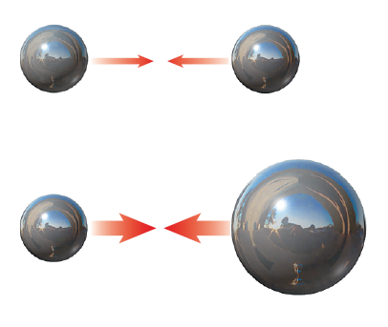
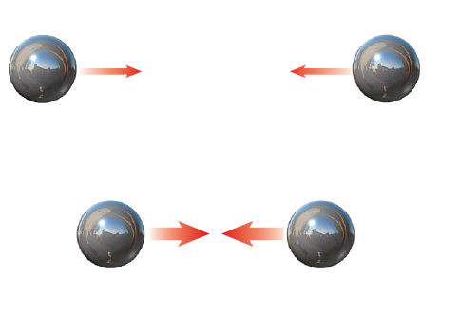
What is gravity?
Gravity is an attractive force between any two objects that depends on the masses of the objects and the distance between them.
If the mass of either of the objects increases, the gravitational force between them increases.
If the objects are closer together, the gravitational force between them increases.
Forces
Copyright © McGraw-Hill Education

Slide 10
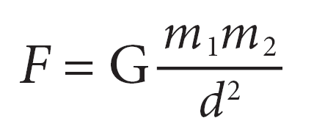
The Law of Universal Gravitation
Isaac Newton formulated the law of universal gravitation, which he published in 1687. This law can be written as the following equation:
Forces
Copyright © McGraw-Hill Education

Slide 11
The Law of Universal Gravitation
In this equation, G is a constant called the universal gravitational constant, and d is the distance between the two masses, m₁ and m₂.
The law of universal gravitation enables the force of gravity to be calculated between any two objects if their masses and the distance between them is known.
Forces
Copyright © McGraw-Hill Education

Slide 12
The Gravitational Field
A field is a region of space that has a physical quantity (such as force) at every point.
Because objects do not have to be in contact, gravity is sometimes discussed as a field.
The strength of the gravitational field is 9.8 N/kg near Earth’s surface and gets smaller as you move away from Earth.
Forces
Copyright © McGraw-Hill Education

Slide 13
Weight
The gravitational force exerted on an object is called the object’s weight.
Because the weight of an object on Earth is equal to the force of Earth’s gravity on the object, weight can be calculated from this equation:
Weight Equation
Weight (N) = mass (kg) x gravitational strength (m/s2)
Forces
Copyright © McGraw-Hill Education

Slide 14
Weight and Mass
The weight of an object usually is the gravitational force between the object and Earth.
Weight and mass are not the same.
Weight and mass are related. Weight increases as mass increases.
The weight of an object can change, depending on the gravitational force on the object.
Mass is a measure of the amount of matter an object contains.
Forces
Copyright © McGraw-Hill Education

Slide 15
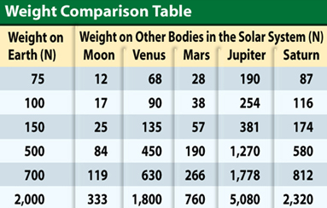
Weight and Mass
The table shows how various weights on Earth would be different on the Moon and some of the planets.
Forces
Copyright © McGraw-Hill Education

Slide 16
SOLVE FOR WEIGHT
Use with Example Problem 1.
Problem
An elephant has a mass of 5,000 kg. What is the elephant’s weight?
SOLVE FOR THE UNKNOWN
Set Up the Problem
F_{g} = mg
Solve the Problem
F_{g} = (5,000 kg)(9.8 N/kg)
= 49,000 N
Response
ANALYZE THE PROBLEM
KNOWN
mass: m = 5,000 kg
gravitational strength: g = 9.8 N/kg
UNKNOWN
weight: F_{g}
EVALUATE THE ANSWER
The gravitational strength is about 10 N/kg, so we would expect the elephant’s weight to be about 50,000 kg. Our answer (F_{g} = 49,000 N) makes sense.
Forces
Copyright © McGraw-Hill Education

Slide 17
A martian on mars has a mass of 226 kg. The force of gravity on mars is 3.7 m/s2. What is the weight of the martian?

Slide 18
Review
Essential Questions
How are force and motion related?
How is the net force on an object determined?
Why is there friction between objects?
What is the difference between mass and weight?
Vocabulary
force
net force
friction
gravity
field
weight
Forces
Copyright © McGraw-Hill Education

