Slide 1
Essential Questions
How does Newton’s first law explain what happens in a car crash?
How does Newton’s second law explain the effects of air resistance?
When is momentum conserved?
Using Newton’s Laws
Copyright © McGraw-Hill Education

Slide 2
Vocabulary
Review
momentum
New
air resistance
terminal velocity
free fall
centripetal force
law of conservation of momentum
Using Newton’s Laws
Copyright © McGraw-Hill Education

Slide 3
What happens in a crash?
Newton’s first law of motion can explain what happens in a car crash.
When the car abruptly stops, the passengers will continue to move unless acted on by an outside force.
Safety belts and air bags counteract the force of inertia to reduce injuries.
Using Newton’s Laws
Copyright © McGraw-Hill Education

Slide 4
Newton’s Second Law and Gravitational Acceleration
When all forces except gravity acting on a falling object can be ignored, the object is said to be in free fall.
Close to Earth’s surface, the acceleration of a falling object in free fall is about 9.8 m/s².
This acceleration is given the symbol g and is called acceleration due to gravity.
If an object is in free fall near Earth’s surface, the net force on it equals the force of gravity (F_{net} = F_{g}).
https://www.youtube.com/watch?v=E43-CfukEgs
Using Newton’s Laws
Copyright © McGraw-Hill Education

Slide 5
Earth’s Gravitational Acceleration
You can use Newton’s second law to show that for an object in free fall, its acceleration due to gravity is equal to g:
Using Newton’s Laws
Copyright © McGraw-Hill Education

Slide 6
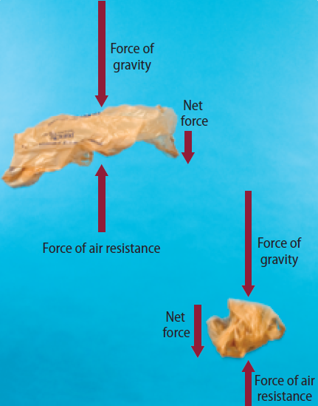
Air Resistance
A friction-like force called air resistance opposes the motion of objects that move through the air.
Using Newton’s Laws
Copyright © McGraw-Hill Education

Slide 7
Air Resistance
The amount of air resistance on an object depends on the speed, size, and shape of the object.
Air resistance, not the object’s mass, is why feathers, leaves, and pieces of paper fall more slowly than pennies, acorns, and apples.
Using Newton’s Laws
Copyright © McGraw-Hill Education

Slide 8
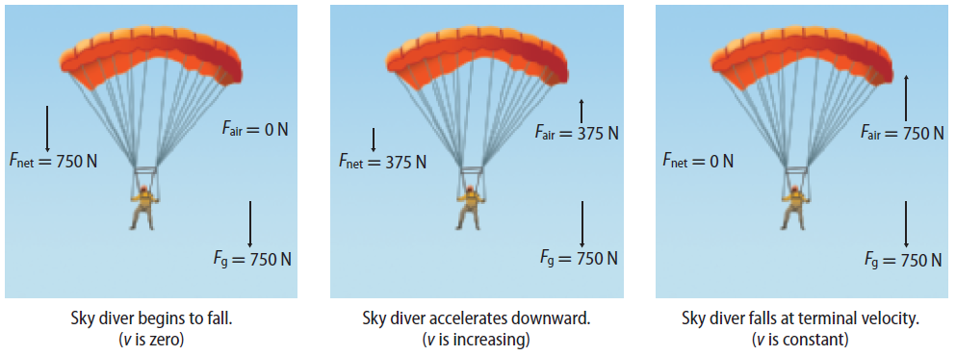
Terminal Velocity https://www.youtube.com/watch?v=pr78Db9qqeI
The terminal velocity is the highest speed a falling object will reach. The terminal velocity depends on the size, shape, and mass of a falling object.
As an object falls, the downward force of gravity causes the object to accelerate.
Using Newton’s Laws
Copyright © McGraw-Hill Education

Slide 9
Terminal Velocity
As an object falls faster, the upward force of air resistance increases.
This causes the net force on a sky diver to decrease as the sky diver falls.
Using Newton’s Laws
Copyright © McGraw-Hill Education

Slide 10
Terminal Velocity
Finally, the upward air resistance force becomes large enough to balance the downward force of gravity. This means the net force on the object is zero.
Then the acceleration of the object is also zero, and the object falls with a constant speed called the terminal velocity.
Using Newton’s Laws
Copyright © McGraw-Hill Education

Slide 11
Weightlessness and Free Fall
You’ve probably seen pictures of astronauts and equipment floating inside the International Space Station.
They are said to be experiencing the sensation of weightlessness.
According to the law of universal gravitation, at 400-km altitude the force of Earth’s gravity is about 90 percent as strong as it is at Earth’s surface.
So an astronaut with a mass of 80 kg still would weigh about 700 N in orbit, compared with a weight of about 780 N at Earth’s surface.
The astronaut is not weightless.
Using Newton’s Laws
Copyright © McGraw-Hill Education

Slide 12
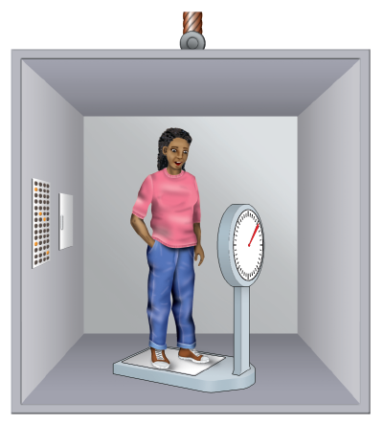
Weightlessness
So what does it mean to say that something is weightless?
When you stand on a scale you are at rest and the net force on you is zero.
The scale supports you and balances your weight by exerting an upward force.
The dial on the scale shows the upward force exerted by the scale, which is your weight.
Using Newton’s Laws
Copyright © McGraw-Hill Education

Slide 13
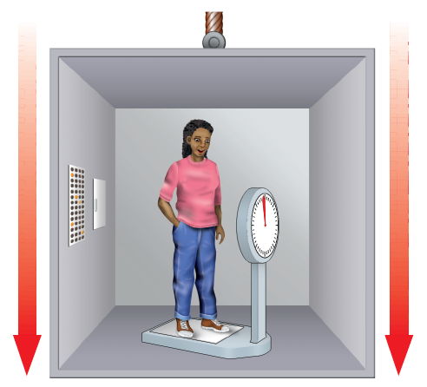
Weightlessness
Now suppose you stand on the scale in an elevator that is falling and the only force on you, the scale, and the elevator is gravity.
If you and the scale were in free fall, then you no longer would push down on the scale at all and the scale would not push up on you.
The scale dial would say you have zero weight, even though the force of gravity on you hasn’t changed.
Using Newton’s Laws
Copyright © McGraw-Hill Education

Slide 14
Floating in Space
A spacecraft in orbit is in free fall, but it is falling around Earth, rather than straight downward.
Everything in the orbiting spacecraft is falling around Earth at the same rate, in the same way you and the scale were falling in the elevator.
Objects in the spacecraft seem to be floating because they are all falling with the same acceleration.
Using Newton’s Laws
Copyright © McGraw-Hill Education

Slide 15
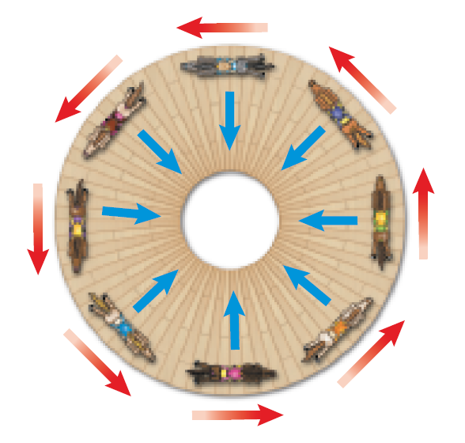
Centripetal Forces https://www.youtube.com/watch?v=KvCezk9DJfk
The net force exerted toward the center of a curved path is called a centripetal force.
Anything that moves in a circle is doing so because a centripetal force is accelerating it toward the center.
Using Newton’s Laws
Copyright © McGraw-Hill Education

Slide 16
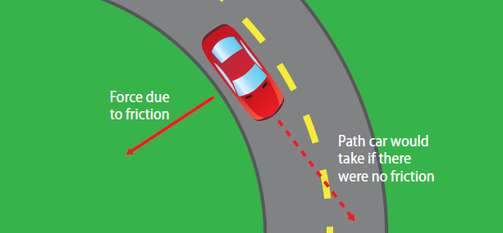
Centripetal Force and Traction
When a car rounds a curve on a highway, a centripetal force must be acting on the car to keep it moving in a curved path.
This centripetal force is the frictional force, or the traction, between the tires and the road surface.
Using Newton’s Laws
Copyright © McGraw-Hill Education

Slide 17
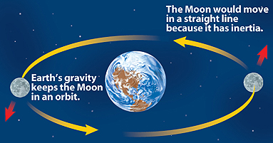
Centripetal Force
Imagine whirling an object tied to a string above your head. The string exerts a centripetal force on the object that keeps it moving in a circular path.
In the same way, Earth’s gravity exerts a centripetal force on the Moon that keeps it moving in a nearly circular orbit.
Using Newton’s Laws
Copyright © McGraw-Hill Education

Slide 18
Force and Changing Momentum
Recall that acceleration is the difference between the initial and final velocity, divided by the time. Also, from Newton’s second law, the net force on an object equals its mass times its acceleration.
By combining these two relationships, Newton’s second law can be written in this way:
In this equation mv_{f} is the final momentum and mv_{i} is the initial momentum.
Using Newton’s Laws
Copyright © McGraw-Hill Education

Slide 19
Law of Conservation of Momentum
The law of conservation of momentum states that if no external forces act on a group of objects, their total momentum doesn’t change. That is, momentum is conserved.
The momentum of an object doesn’t change unless its mass, velocity, or both change.
Momentum, however, can be transferred from one object to another.
https://www.youtube.com/watch?v=e1lzB36aHD4
Using Newton’s Laws
Copyright © McGraw-Hill Education

Slide 20
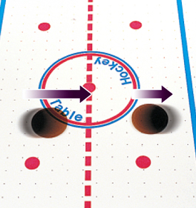
When Objects Collide
The results of a collision depend on the momentum of each object.
When the first puck hits the second puck from behind, it gives the second puck momentum in the same direction.
Using Newton’s Laws
Copyright © McGraw-Hill Education

Slide 21
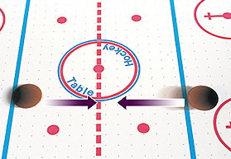
When Objects Collide
If the pucks are speeding toward each other with the same speed, the total momentum is zero.
Using Newton’s Laws
Copyright © McGraw-Hill Education

Slide 22
Rocket Propulsion
In a rocket engine, burning fuel produces hot gases. The rocket engine exerts a force on these gases and causes them to escape out the back of the rocket.
By Newton’s third law, the gases exert a force on the rocket and push it forward.
Using Newton’s Laws
Copyright © McGraw-Hill Education

Slide 23
Review
Essential Questions
How does Newton’s first law explain what happens in a car crash?
How does Newton’s second law explain the effects of air resistance?
When is momentum conserved?
Vocabulary
air resistance
terminal velocity
free fall
centripetal force
law of conservation of momentum
Using Newton’s Laws
Copyright © McGraw-Hill Education

